Slide 1


Green Pace
Security Policy Presentation
Developer: Nate Riggs
Notes:
Good afternoon. Today I'm presenting Green Pace's new Security Policy, which establishes comprehensive coding standards and security practices for our development team. My name is Nate Riggs, and I'll walk you through how we're transitioning from DevOps to DevSecOps to build security into every phase of our development lifecycle.

Slide 2

OVERVIEW: DEFENSE IN DEPTH
Why is this Policy Needed?
Standardize implicit security practices as Green Pace grows
Transition from DevOps to DevSecOps for stronger security
Prepare for security audits and ensure compliance
Protect applications for environmentally responsible clients worldwide
How It Supports Defense-in-Depth
Creates multiple layers of security protection
Integrates 10 coding standards, encryption policies, and Triple-A framework
Automates security throughout the development pipeline
If one layer fails, others continue protecting the system
Notes:
This security policy is needed for several key reasons. First, as Green Pace grows, we need to standardize the implicit security practices our team already follows. Second, we're transitioning from DevOps to DevSecOps to embed stronger security throughout our pipeline. Third, we need to prepare for security audits and ensure compliance as we serve environmentally responsible clients worldwide.
This policy supports defense-in-depth by creating multiple layers of security protection. It integrates 10 coding standards, encryption policies, and the Triple-A framework. Security is automated throughout our development pipeline, so if one layer fails, others continue protecting the system.

Slide 3
THREATS MATRIX
Prioritized by severity, likelihood, and cost. Top-left = highest risk, requiring immediate action.
Automated tools scan every pull request. High-severity violations block merges.
Likely STD-002-CPP STD-003-CPP STD-004-CPP STD-008-CPP | Priority STD-001-CPP STD-005-CPP STD-009-CPP
Low priority STD-007-CPP STD-010-CPP | Unlikely STD-006-CPP
Notes:
This threats matrix categorizes our 10 coding standards by likelihood and priority. The standards are prioritized by three factors: severity, which measures potential damage; likelihood, which measures probability of occurrence; and remediation cost, which measures difficulty to fix. The top-left quadrant shows our highest-risk vulnerabilities requiring immediate attention—SQL injection and input validation pose the greatest threats to Green Pace systems.
We've integrated automated detection tools including Clang Static Analyzer, Cppcheck, SonarQube, and Coverity. These tools scan every pull request automatically, and high-severity violations block code merges, catching vulnerabilities before they reach production.

Slide 4
10 PRINCIPLES
Security Principle | Applicable Coding Standard(s)
Validate Input Data | STD-002, STD-003, STD-004, STD-008, STD-009, STD-010
Heed Compiler Warnings | All Coding Standards
Architect and Design for Security Policies | All Coding Standards
Keep It Simple | STD-001, STD-005, STD-006, STD-007
Default Deny | STD-002, STD-004, STD-008, STD-010
Adhere to the Principle of Least Privilege | STD-005
Sanitize Data Sent to Other Systems | STD-004
Practice Defense in Depth | STD-003, STD-005, STD-007, STD-008, STD-009, STD-010
Use Effective Quality Assurance Techniques | STD-006, STD-007, STD-009
Adopt a Secure Coding Standard | All Coding Standards
Notes:
Our security policy is built on 10 core security principles that guide all development work. Each principle maps to specific coding standards, showing how theory translates into practice. For example, the principle 'Validate Input Data' is implemented through six different standards including data value validation, string operations, SQL injection prevention, and input validation. Similarly, 'Practice Defense in Depth' appears in six standards, ensuring we have multiple layers of protection. Some principles like 'Heed Compiler Warnings' and 'Adopt a Secure Coding Standard' apply to all ten standards, creating a foundation that supports everything we build.

Slide 5
CODING STANDARDS
1. STD-004-CPP - Use Parameterized Queries to Prevent SQL Injection
2. STD-008-CPP - Validate All Input from External Sources
3. STD-002-CPP - Validate Data Values Within Expected Ranges
4. STD-003-CPP - Use Safe String Operations to Prevent Buffer Overflows
5. STD-005-CPP - Properly Manage Dynamic Memory
6. STD-009-CPP - Prevent Integer Overflow/Underflow
7. STD-001-CPP - Use Appropriate Data Types for Variables
8. STD-006-CPP - Use Assertions to Verify Program Assumptions
9. STD-007-CPP - Handle Exceptions Properly
10. STD-010-CPP - Prevent Null Pointer Dereferences
Notes:
Here are our 10 coding standards ranked in priority order. At the top, Level 4 standards address SQL injection prevention and input validation—these are critical because they're high severity, highly likely, and can be exploited remotely. Level 3 standards include data value validation, safe string operations, memory management, and integer overflow prevention. Level 2 standards cover appropriate data types, assertions, exception handling, and null pointer dereferences.
Our prioritization system ranks standards by three equally-weighted factors: severity, likelihood, and remediation cost. Higher-ranked standards pose greater risk to Green Pace systems and our clients' data.

Slide 6
ENCRYPTION POLICIES
Encryption at Rest
Protects stored data on hard drives, databases, backups, and cloud storage. All sensitive data must be encrypted using AES-256 or stronger before storage. Keys are managed separately from encrypted data. Ensures stolen or improperly disposed storage media remains unreadable without decryption keys.
Encryption in Flight
Protects data traveling across networks between systems or users. All transmissions must use TLS 1.2+, SSH, or VPNs. Applies to server traffic, client communications, API calls, and database connections. Prevents man-in-the-middle attacks and network eavesdropping.
Encryption in Use
Protects data during active processing in memory or CPU. Sensitive data remains encrypted using secure enclaves or trusted execution environments. Applies to payment processing, key operations, PII analytics, and credential verification. Protects against memory dumps and side-channel attacks.
Notes:
Our encryption policies cover three types of data protection. Encryption at rest protects stored data on hard drives, databases, backups, and cloud storage using AES-256 or stronger, with keys managed separately from encrypted data. This ensures that stolen or improperly disposed storage media remains unreadable.
Encryption in flight protects data traveling across networks using TLS 1.2 or higher, SSH, or VPNs. This applies to all server traffic, client communications, API calls, and database connections, preventing man-in-the-middle attacks.
Encryption in use protects data during active processing in memory or CPU using secure enclaves or trusted execution environments. This applies to payment processing, key operations, and credential verification, protecting against memory dumps and side-channel attacks.

Slide 7
TRIPLE-A POLICIES
Authentication
Verifies the identity of users, systems, or devices accessing Green Pace resources. Multi-factor authentication (MFA) required for all accounts accessing development systems, production environments, and administrative interfaces. Authentication must include at least two factors: something known (password), something possessed (token/phone), or something inherent (biometrics). Strong passwords require minimum 12 characters with complexity requirements.
Authorization
Determines what authenticated users are permitted to do after identity verification. Role-based access control (RBAC) grants permissions based on job functions and least privilege. Users receive only minimum permissions necessary for their duties, with elevated privileges granted temporarily and logged. Authorization changes must be reviewed and approved by managers. Prevents privilege escalation and limits damage from compromised accounts.
Accounting
Tracks and logs all security-relevant activities. Comprehensive logging includes user logins/logouts, database changes, user account modifications, permission changes, file access, and privileged operations. Logs must be tamper-proof, retained per compliance requirements, and monitored for suspicious patterns. Creates audit trail for forensic investigation and ensures accountability.
Notes:
The Triple-A framework establishes our authentication, authorization, and accounting policies. Authentication verifies identity using multi-factor authentication for all accounts accessing development systems, production environments, and administrative interfaces. Users must provide at least two factors: something they know, something they possess, or something they are.
Authorization determines what authenticated users can do through role-based access control and the principle of least privilege. Users receive only the minimum permissions necessary, with elevated privileges granted temporarily and logged.
Accounting tracks and logs all security-relevant activities including user logins, database changes, account modifications, permission changes, and file access. Logs must be tamper-proof and monitored for suspicious patterns, creating an audit trail for forensic investigation.

Slide 8
Unit Testing
Notes:
Now I'll demonstrate how we use unit testing to validate our security standards through automated vulnerability detection.

Slide 9
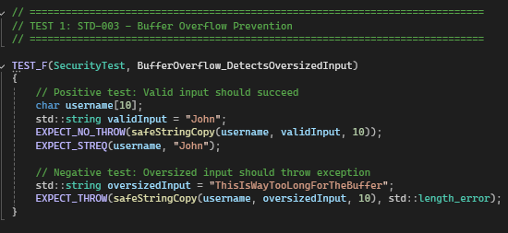
Does Safe String Copy Prevent Buffer Overflow? (STD-003-CPP)
Notes:
This test validates STD-003, our buffer overflow prevention standard. The positive test confirms that valid input like 'John' is accepted into a 10-byte buffer. The negative test confirms that oversized input, 28 characters in this case, is rejected and throws an exception before the buffer overflow can occur. This prevents attackers from exploiting buffer overflows to execute arbitrary code. As you can see, the test passed successfully.

Slide 10
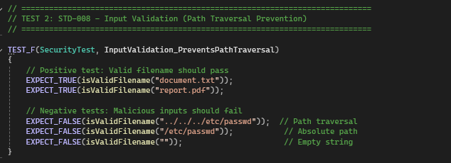
Does Input Validation Block Path Traversal Attacks? (STD- 008-CPP)
Notes:
This test validates STD-008, our input validation standard. The positive tests confirm legitimate filenames like 'document.txt' and 'report.pdf' are accepted. The negative tests confirm that path traversal attempts like '../../../etc/passwd', absolute paths, and empty strings are all blocked. This prevents directory traversal attacks where attackers try to access files outside the intended directory. The test passed, confirming our validation logic works correctly.

Slide 11
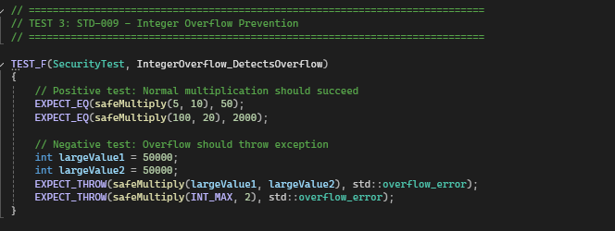
Does Pre-Calculation Validation Detect Integer Overflow? (STD-009-CPP)
Notes:
This test validates STD-009, our integer overflow prevention standard. The positive tests show normal calculations work correctly—5 times 10 equals 50. The negative tests confirm that large multiplications that would cause overflow, like 50,000 times 50,000 or INT_MAX times 2, are detected and throw exceptions before producing incorrect results. This is critical for financial calculations and resource allocation. The test passed successfully.

Slide 12
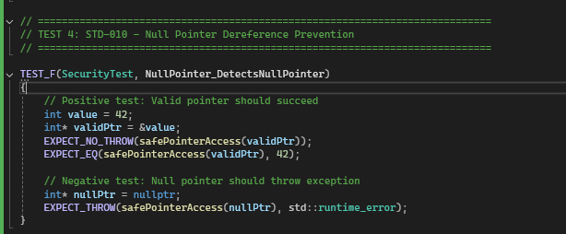
Are Null Pointers Caught Before Dereferencing? (STD-010-CPP)
Notes:
This test validates STD-010, our null pointer prevention standard. The positive test shows that valid pointers are successfully accessed and return the expected value of 42. The negative test confirms that null pointers are detected and an exception is thrown before dereferencing can occur. This prevents crashes and potential security exploits from null pointer dereferences. The test passed, showing all pointers are validated before use.

Slide 13
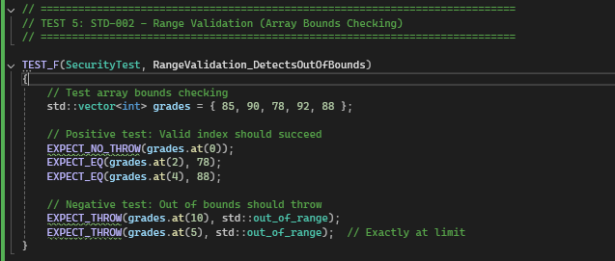
Does Range Validation Prevent Out-of-Bounds Access? (STD-002-CPP)
Notes:
This test validates STD-002, our range validation standard. The positive tests show that valid array indices—0, 2, and 4—work correctly and return the expected values. The negative tests confirm that out-of-bounds indices like 10 and 5 throw exceptions before memory corruption can occur. This ensures data access stays within safe boundaries. The test passed successfully.

Slide 14
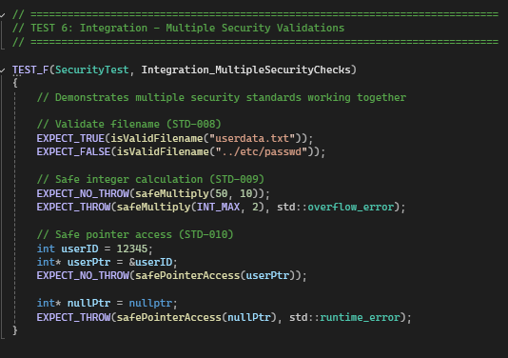
Do Multiple Security Standards Work Together? (STD-008-CPP, STD-009-CPP, STD-010-CPP)
Notes:
This integration test demonstrates multiple security standards working together. It validates filename input using STD-008, performs safe integer calculations using STD-009, and checks pointers using STD-010—all in one test scenario. This demonstrates our defense-in-depth strategy where multiple security layers work together. If one control fails, others continue protecting the system. The test passed, showing all standards function together seamlessly.

Slide 15

AUTOMATION SUMMARY

Slide 16
TOOLS
DevSecOps Pipeline
Operates as a continuous figure-eight cycle where security is integrated at every stage rather than added at the end. This approach embeds security automation throughout the entire development lifecycle, creating multiple checkpoints to catch vulnerabilities early
External Tools and where they fit
Build
Static analysis tools (SonarQube, Clang, Coverity, Cppcheck) scan every pull request and block merges for violations.
Verify & Test
Runtime analyzers (AddressSanitizer, Valgrind) detect memory issues during execution.
Transition
Final security scans and code signing verify compliance before deployment.
Monitor & Detect
RASP and WAF detect exploitation attempts in production.
Maintain & Stabilize
Automated dashboards track compliance metrics and security debt.
Notes:
The DevSecOps model operates as a continuous figure-eight cycle where security is integrated at every stage rather than added at the end. This embeds security automation throughout the entire development lifecycle, creating multiple checkpoints to catch vulnerabilities early. The cycle flows through eight phases: Assess and Plan, Design, Build, Verify and Test, Transition and Health Check, Monitor and Detect, Respond, and Maintain and Stabilize, which feeds back to planning for continuous improvement.
Security tools are placed strategically throughout the pipeline. In the Build phase, static analysis tools like SonarQube, Clang, Coverity, and Cppcheck scan every pull request and block merges for violations. In Verify and Test, runtime analyzers like AddressSanitizer and Valgrind detect memory issues during execution. In the Transition phase, final security scans and code signing verify compliance before deployment. In Monitor and Detect, RASP and WAF detect exploitation attempts in production. In Maintain and Stabilize, automated dashboards track compliance metrics and security debt, informing the next planning cycle.

Slide 17
RISKS AND BENEFITS
Problems
Legacy code contains undetected vulnerabilities from manual-only reviews
No automated enforcement of security standards before deployment
Security testing occurs too late in the development cycle
Inconsistent secure coding practices across development team
Solutions
Implement 10 coding standards with automated SAST tool enforcement
Integrate DevSecOps model with security at every development phase
Establish Triple-A framework and encryption policies across all systems
Require MFA, RBAC, and comprehensive logging for accountability
Benefits of Acting Now
Catch vulnerabilities during development when cheapest to fix
Build security culture into growing team before bad habits form
Automated tools scale with team growth without proportional cost increase
Protect client data and meet compliance requirements for audits
Risks of Waiting
Vulnerabilities compound as codebase grows, creating exponential remediation costs
Potential data breach damages client relationships and company reputation
Security debt becomes increasingly difficult to pay down
Competitors with stronger security posture win environmentally-conscious clients
Notes:
We're addressing several critical problems: legacy code contains undetected vulnerabilities, we lack automated security enforcement before deployment, security testing occurs too late, and coding practices are inconsistent across the team.
Our solutions include implementing 10 coding standards with automated enforcement, integrating the DevSecOps model, establishing the Triple-A framework and encryption policies, and requiring MFA and comprehensive logging.
The benefits of acting now are clear: we catch vulnerabilities when they're cheapest to fix, build security culture before bad habits form, scale automated tools with team growth, and protect client data while meeting compliance requirements.
The risks of waiting are equally significant: vulnerabilities compound as our codebase grows, potential breaches could damage our reputation, security debt becomes harder to pay down, and competitors with stronger security will win environmentally-conscious clients.

Slide 18
RECOMMENDATIONS
Incident Response Plan
No formal process for responding to security incidents or breaches
Need documented procedures for containment, investigation, and recovery
Requires defined roles and communication protocols during incidents
Third-Party Risk Management
Missing policies for vetting third-party libraries and dependencies
No process for tracking known vulnerabilities in external components
Need guidelines for evaluating security of vendor integrations
Security Training Program
Lack of mandatory secure coding training for new developers
No ongoing education program for emerging threats and vulnerabilities
Need regular security awareness training for all technical staff
Penetration Testing Schedule
No regular penetration testing or red team exercises defined
Missing process for validating that coding standards actually prevent exploits
Need scheduled external security assessments
Notes:
Despite this comprehensive policy, we've identified gaps that still need to be addressed. First, we lack a formal incident response plan with documented procedures for containment, investigation, and recovery. Second, we're missing third-party risk management policies for vetting libraries and tracking vulnerabilities in external components. Third, we lack mandatory security training for developers and ongoing education about emerging threats. Finally, we haven't established a penetration testing schedule to validate that our standards actually prevent exploits in practice.

Slide 19
CONCLUSIONS
Align coding standards with evolving OWASP vulnerabilities
Integrate OWASP dependency checking into build pipeline
Adopt SLSA framework and software bill of materials
Verify signatures and provenance of all dependencies
Establish secure container configuration standards
Implement secrets management for cloud deployments
Enforce authentication, rate limiting, and input validation for all APIs
Implement API gateway with security controls
Notes:
Looking to the future, we should adopt several additional standards. We should integrate the OWASP Top 10, aligning our standards with evolving vulnerabilities. We should adopt supply chain security including the SLSA framework and software bill of materials. We need container and cloud security standards for secure configurations and secrets management. Finally, we should establish API security standards with authentication, rate limiting, and input validation. These future standards will keep Green Pace ahead of emerging threats as our technology stack evolves.

Slide 20
References
Clang Team. (2023). Clang Static Analyzer checkers. https://clang.llvm.org/docs/analyzer/checkers.html
Coverity. (2023). Static application security testing (SAST). Synopsys. https://www.synopsys.com/software-integrity/security-testing/static-analysis-sast.html
Cppcheck Team. (2023). Cppcheck manual. https://cppcheck.sourceforge.io/
GitHub. (2023). CodeQL for C++. https://codeql.github.com/codeql-query-help/cpp/
Micro Focus. (2023). Fortify static code analyzer. https://www.microfocus.com/en-us/cyberres/application-security/static-code-analyzer
OWASP Foundation. (2021). OWASP Top 10 - 2021. https://owasp.org/Top10/
PVS-Studio. (2023). PVS-Studio static analyzer documentation. https://pvs-studio.com/en/docs/
SonarSource. (2023). SonarQube C++ rules. https://rules.sonarsource.com/cpp/
The LLVM Project. (2023). AddressSanitizer. https://clang.llvm.org/docs/AddressSanitizer.html
Valgrind Developers. (2023). Valgrind Memcheck manual. https://valgrind.org/docs/manual/mc-manual.html

